Slide 1

DataSys Coin (DSC) Blockchain
Illinois Institute of Technology Team: NBV
Members: Batkhishig Dulamsurankhor (bdulamsurankhor@hawk.iit.edu)
Nitin Singh (nsingh33@hawk.iit.edu)
Vaishnavi Papudesi Babu (vpapudesibabu@hawk.iit.edu)

Slide 2
Benefits of Blockchain Technology
Enhanced Security: Blockchain technology provides enhanced security through encryption and decentralized data storage.
Transparency and Traceability: Blockchain ensures transparency and traceability of transactions, reducing fraud and improving accountability.
Efficiency and Cost Savings: Blockchain eliminates intermediaries, streamlining processes, and reducing costs.

Slide 3
Technologies used:
Python
Flask
Serialization and Hashing from Cryptography Module
SHA256 to create keys and base58 for encoding
Blake3 for hashing in validators
Fingerprint function using UUID

Slide 4
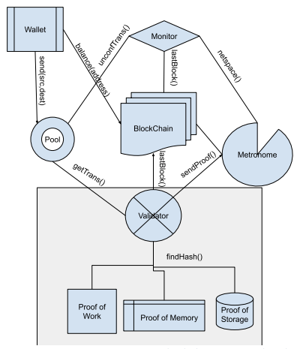
The Architecture:
DataSys Coin Blockchain Centralized Architecture

Slide 5
Libraries Used
Cryptography
Base58
Blake3
Hashlib
Flask
Apscheduler
Bintrees

Slide 6
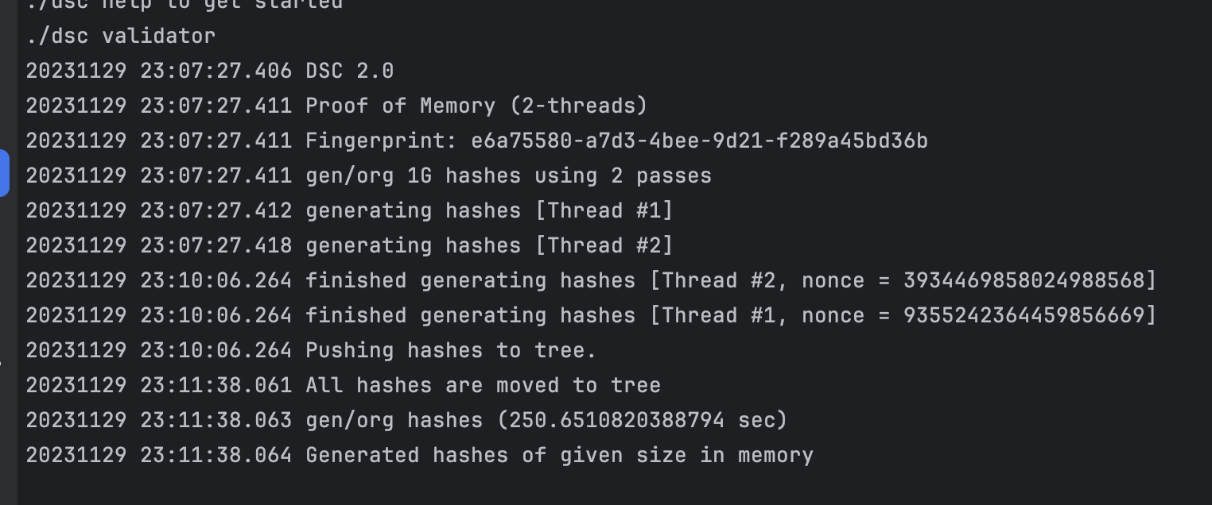
Validator + PoW/PoM/PoS
PoM takes ~250 sec to generate 1Gb hashes in a file.

Slide 7
.. Validators
Get Transactions from Pool: Validators retrieve transactions from the pool for inclusion in a new block.
Verify Transactions: Validators verify the validity of transactions before adding them to a block.
Ask Other Validators to Verify Block:
Validators request other validators to verify a block before finalizing it.
Send Final Block to Blockchain: Validators send the finalized block to the DataSys Coin (DSC) Blockchain for permanent storage.

Slide 8
Blockchain
We decided to use array/list over LinkedList.
We used hashmap to implement caching. The keys are wallet addresses and the values are balance and block height.
Wallet: We are signing our message with the private key and pool is verifying the signature and it makes sure that the message is from the owner of the wallet.

Slide 9
Challenges faced
Synchronization between validator, metronome and blockchain
Integrating all the components
….. and more

Slide 10
Thank You
~~~~~~~~~~~~~~~~~~~~~~~~~~~~~~~~~~~~~~~~~~~~~~~~~~

